Slide 1
Case Study - I
Facial Recognition System for ATM Security
Presented by Group - 1
Anurag Watane (11013614)
Vinayak Parab (11013615)
Shivangi Gujar (11012466)
Veneeza Cardozo (11013312)
Nolan Pereira (11013328)
Ashton Lobo (11013300)

Slide 2

Why Face Recognition?
Requirement 2-Step Authentication
Tracking Frauds
Dispute Management

Slide 3
Evolution of NN Models
DCNN AlexNet
(Krizhevsky et al.)
SIFT (Lowe)
HOG
(Dalal & Triggs)
VGGNet
2001
2010
2014
2016
1999
2005
2012
2015
Cascades
(Viola & Jones)
Improved FV
(Perronnin et al.)
RCNN
Inception - ResNet v1
[2]

Slide 4
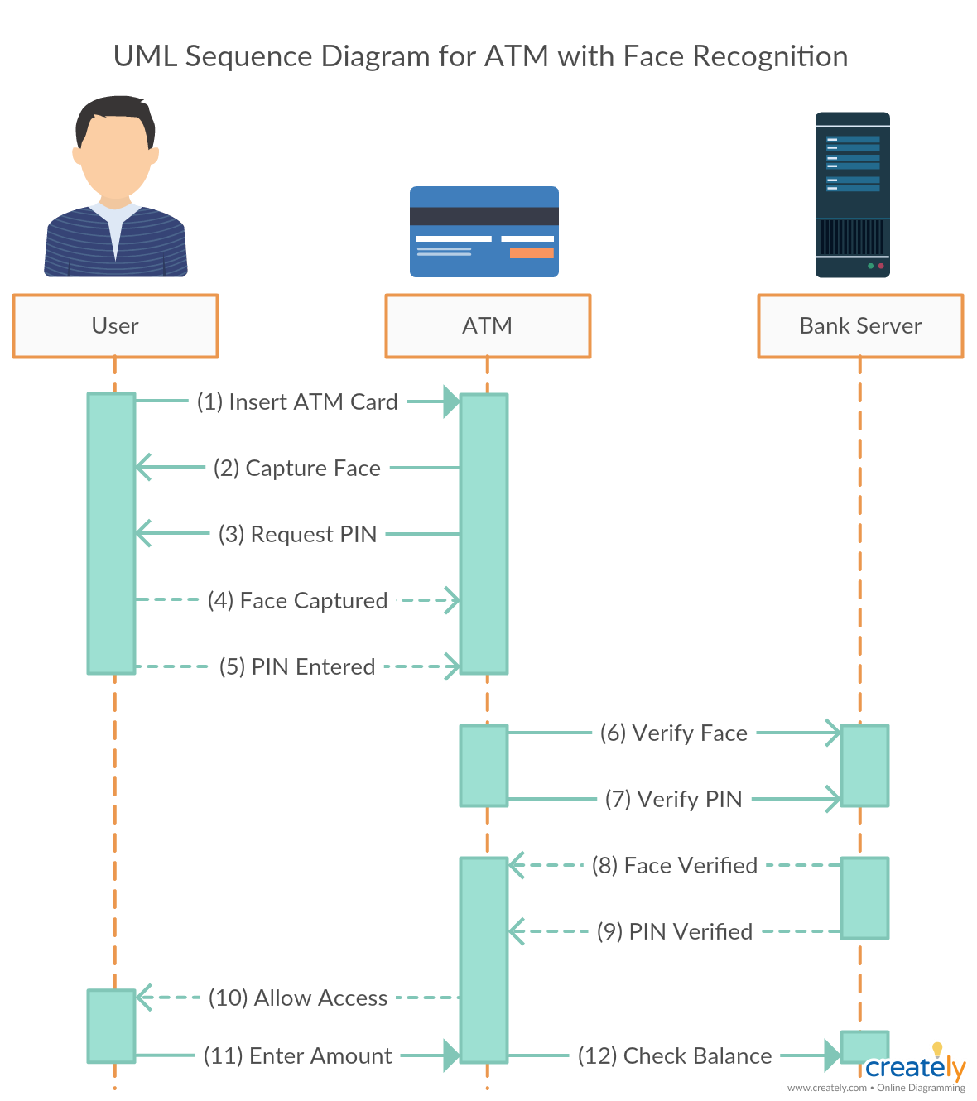
What we want to achieve

Slide 5







Technologies used
Packages Used
Environments Used
Google Colab
Anaconda Env

Slide 6
Related Work
A. Krizhevsky, et Al., [3] showed that very large and deep convolutional networks trained by standard backpropagation can achieve excellent recognition accuracy when trained on a large dataset.
In 2014 K. Simonyan et Al., [4] used VGG-16 architecture for large-scale image classiﬁcation, where they proved that depth is useful for classification accuracy.
In 2018 A. Zhanfu et Al., [5] proposed an approach based on AlexNet model and Inception ResNet-V1 model evaluated on the LFW database; the Inception-ResNet-V1 network achieved a 99.20% recognition rate on LFW.
In 2019 Zhao, Jian et Al., [6] Showed us an architecture, which generates powerful age-invariant face representations explicitly disentangled from the age variation.
In early 2020 Yu, Zitong et Al., [7] showed a frame level Face-Anti Spoofing method based on Central Difference Convolution (CDC), which is able to capture intrinsic detailed patterns via aggregating both intensity and gradient information

Slide 7
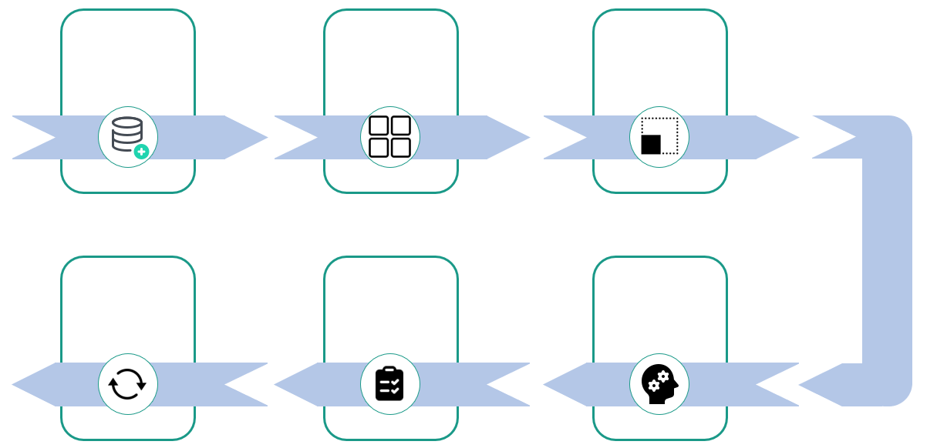
Pipeline
Data Collection
Image Augmentation
Data Alignment
Evaluation
Testing
Training

Slide 8
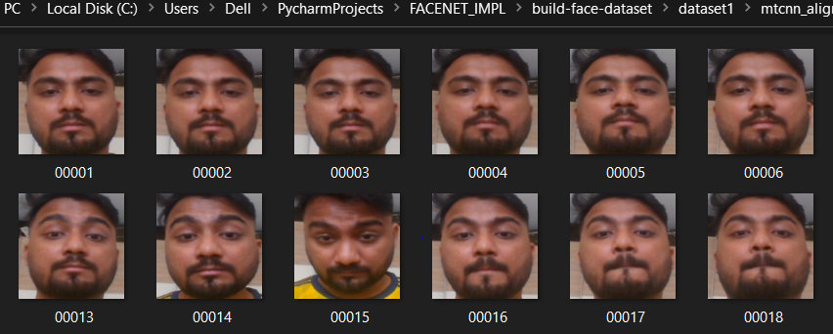
Data Collection
Capture and collect N number of images from video based on user input by using Opencv for creating a custom dataset.

Slide 9

Dataset
Dataset | Classes | Images
Original LFW | 5k+ | 13k+
Revised LFW | 205 | 24k+
Training | 20k+
Testing | 4k+

Slide 10
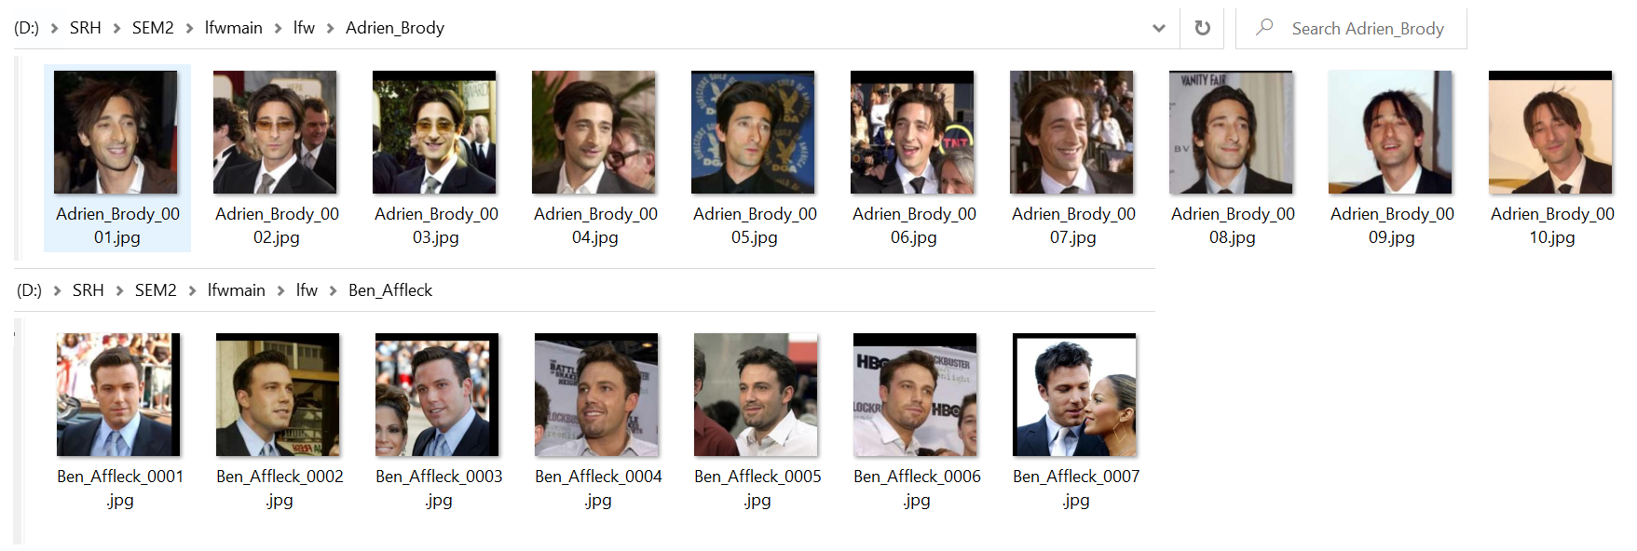

LFW Dataset- Original
Inconsistent count of images per class which resulted in a biased classification

Slide 11
LFW Dataset - Revised
Consistent count of images per class

Slide 12

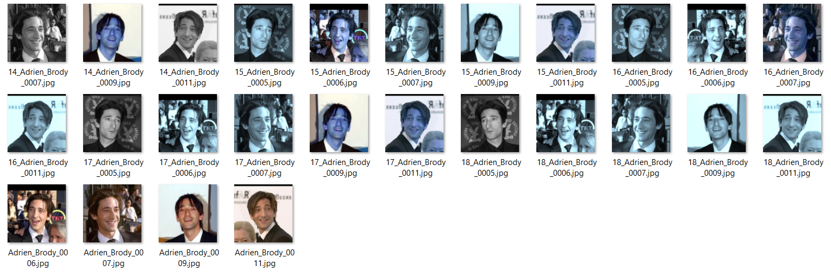
Revised LFW Dataset - Augmented
Image Augmentation of properties based on random probabilities, to create a large dataset

Slide 13
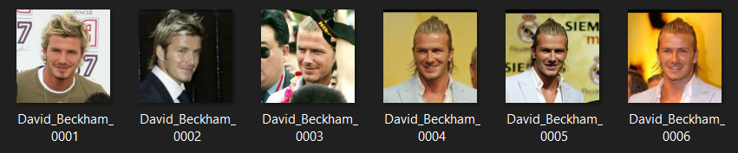
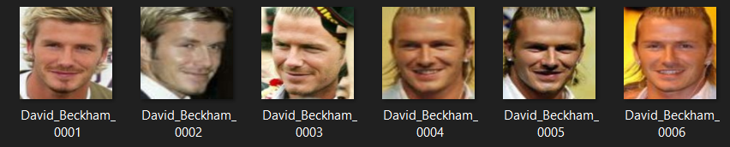
Revised LFW Dataset - Alignment
Preprocessed and aligned the dataset by using MTCNN.
Before Alignment
After Alignment

Slide 14
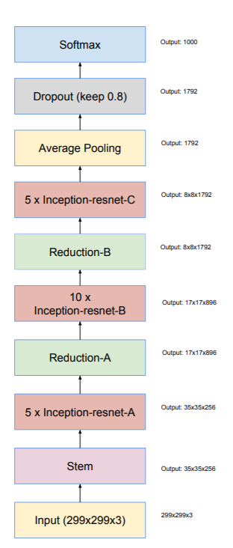
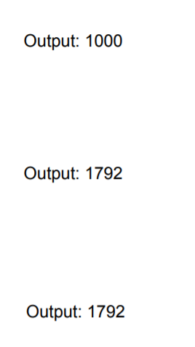
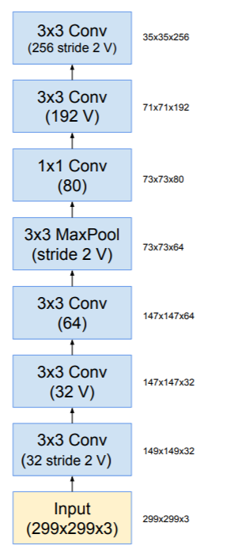
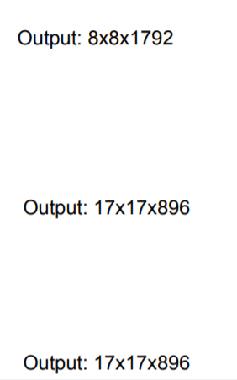
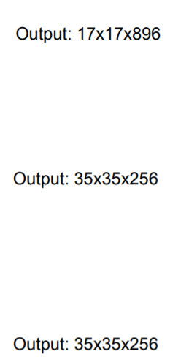
Schematic of the Inception-ResNet v1 model (1/2)
Stem
Input
(160x160x3)
[1]
Input (160x160x3)
Input (160X160X3)

Slide 15
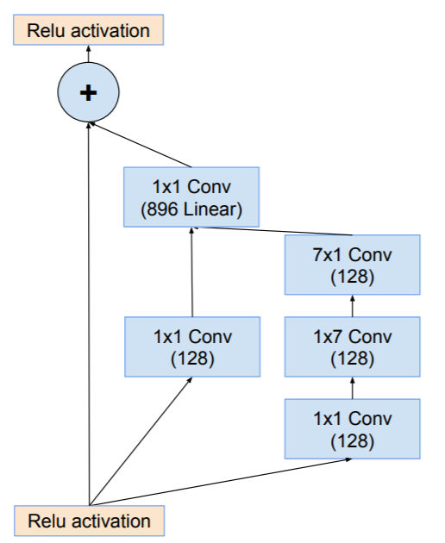
Schematic of the Inception-ResNet v1 model (2/2)
[1]
Input (160x160x3)
Input (160X160X3)

Slide 16
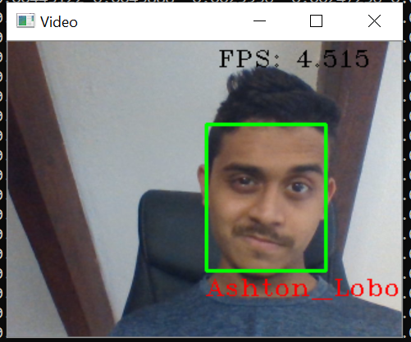


Face Recognition
Trained on 20K Images
206 classes
Achieved accurate real time recognition

Slide 17
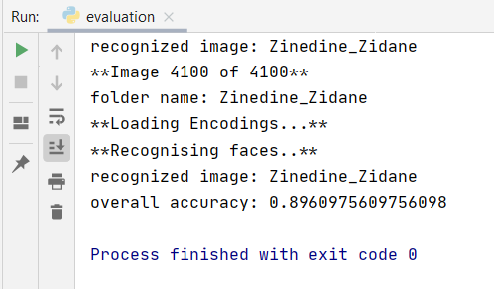
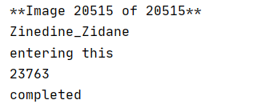
Accuracy of Face Recognition using ResNet model
Trained on 20K images
Tested on 4100 images, belonging to 205 classes
Notes:
After real time recognition , we tested the model on the test dataset and received 89.61% accuracy

Slide 18
Features
Anti-Spoofing
One Face, One Frame
Image Augmentation
Image Alignment

Slide 19
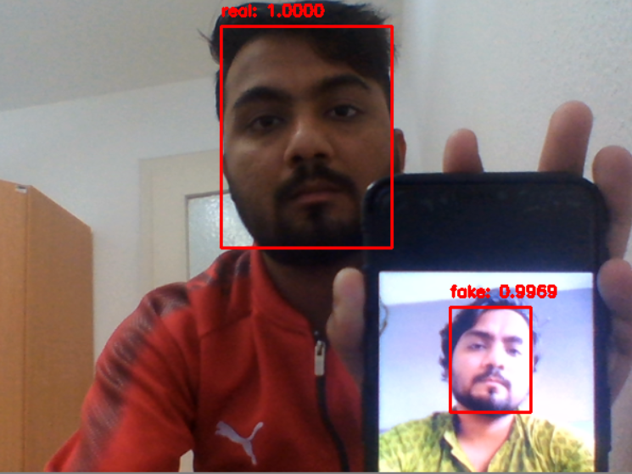
Anti-Spoofing

Slide 20
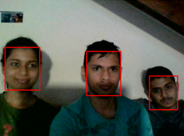
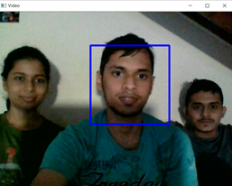
One Face, One Frame
Before
After
Person closest to the camera is the one who gets detected for recognition

Slide 21
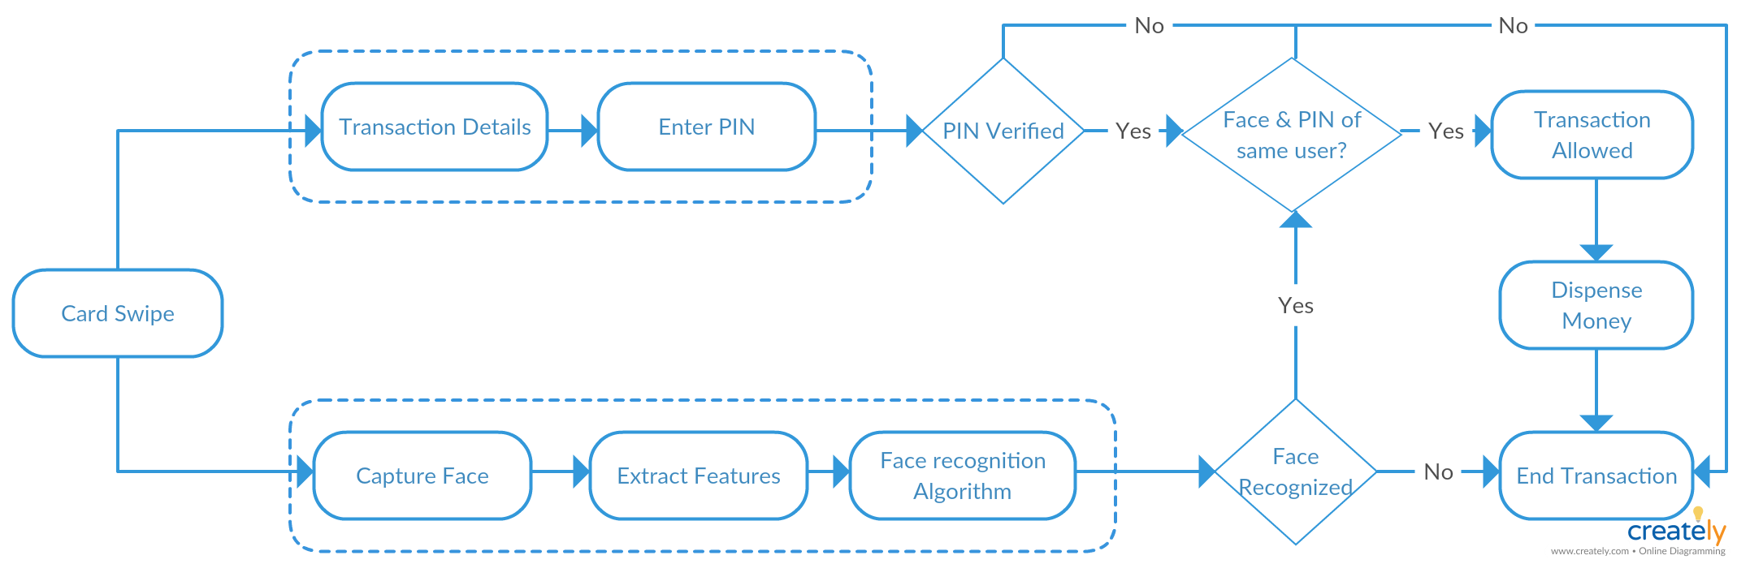
ATM Workflow

Slide 22
Challenges we faced
The facial recognition system could have a large turnaround time which may lead to impatience.
Solution: Extract the facial features using HOG model.
Encode the facial features and store them in Pickle file
Use the encoded facial features to recognize faces.
Simultaneos verification PIN and Face as 2-Step Authentication.
Solution: Use of Multi-Threading
Overfitting the data to the model
Solution: Tuning the hyper parameters

Slide 23
Demo based on User Stories
As a Software Developer, I want to design a simple user interface for the ATM system, so that facial recognition along with 4-digit PIN can be used as 2-step user-authentication process for withdrawing the money.
I, as a data scientist, Want to prepare a working demo of the NN architecture, So that its working can be explained to the audience and based on the accuracy of the model a final decision can be made.
As a software developer, I want to ensure that the face recognition system can not be fooled by showing a mobile photo of the ATM user. Hence, added the liveness detection feature.
As a bank manager I would like the ATM camera to capture only one image per frame in order to avoid disputes caused due to capture of more than one image per frame.
I, as a data scientist, Want to create and use large image datasets, So that I can use these images for the training and testing face recognition models and also achieve the best accuracy for the created model.
As a data scientist i want to pre-process and make my data aligned for training of the model because the images are partial or have background content.

Slide 24
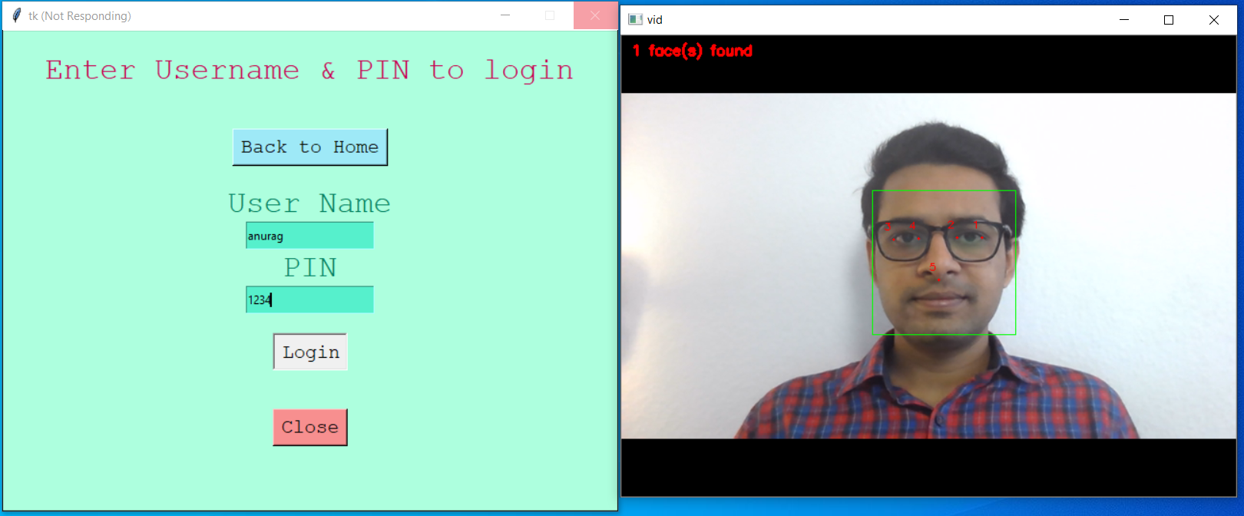
Face Recognition as 2-Step Authentication

Slide 25
Future Scope
Completion of the current work in progress tasks.
Integration of standalone features like anti face spoofing, one image per frame.
Optimizing Layer tweaking and creation of additional layer for higher accuracy.
Implementation with new and large datasets.
Recognition of images based on occlusion
UI help with voice support for blind person

Slide 26
References
Szegedy, Christian & Ioffe, Sergey & Vanhoucke, Vincent & Alemi, Alexander. (2016). Inception-v4, Inception-ResNet and the Impact of Residual Connections on Learning. AAAI Conference on Artificial Intelligence.
Liu, L., Ouyang, W., Wang, X. et al. Deep Learning for Generic Object Detection: A Survey. Int J Comput Vis 128, 261–318 (2020)
A. Krizhevsky, I. Sutskever, and G. Hinton. ImageNet classification with deep convolutional neural networks. In ANIPS, 2012.
K. Simonyan and A. Zisserman, “Very deep convolutional networks for large-scale image recognition,” arXiv Prepr. arXiv1409.1556, 2014.
Zhanfu A, et Al,13th IEEE International Conference on Automatic Face & Gesture Recognition, pp 416-422, 2018.
Zhao, Jian & Cheng, Yu & Cheng, Yi & Yang, Yang & Zhao, Fang & Li, Jianshu & Liu, Hengzhu & Yan, Shuicheng & Feng, Jiashi. (2019). Look across Elapse: Disentangled Representation Learning and Photorealistic Cross-Age Face Synthesis for Age-Invariant Face Recognition. Proceedings of the AAAI Conference on Artificial Intelligence. 33. 9251-9258. 10.1609/aaai.v33i01.33019251.
Yu, Zitong & Qin, Yunxiao & Li, Xiaobai & Wang, Zezheng & Zhao, Chenxu & Lei, Zhen & Zhao, Guoying. (2020). Multi-Modal Face Anti-Spoofing Based on Central Difference Networks. 2766-2774. 10.1109/CVPRW50498.2020.00333.

Slide 27
Thank you

